Slide 1
Chatroom Project
Tim Jassmann
David Kale
Sina Tashakkori

Slide 2
Version 1.0
Server
Client
GUI

Slide 3
Server
TCP persistent connections with clients
Sends error if invalid name(no name), or name in use
Accepts requests of “GETMSGS”, “GETUSERS”, “PUT”, “NAME”
Sends responses of “MSGS”, “USERS”, “OK”
Holds active clients in an array of Tuples (socket, name, messages to send)
Removes clients after they disconnect

Slide 4
Client
Contains a GUI object
Threaded to run GUI and client at same time
Communicates with GUI through signals
Connects to server then immediately sends a NAME request and checks for OK
Alternates between get_users and get_messages with a .25 second sleep before each get_users
get_users and get_messages send their appropriate request then parse their request and send the appropriate signal to GUI

Slide 5
GUI
PyQT
Qt is a cross-platform application and UI framework
Users - QTextEdit
Chat Log – QTextEdit
Text Input – QLineEdit
Send Button - QPushButton

Slide 6
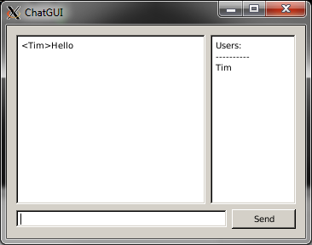
GUI

Slide 7
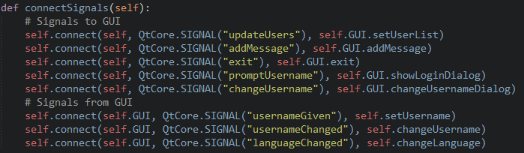
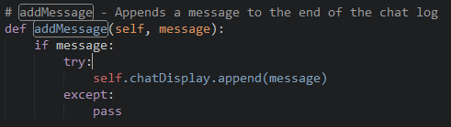
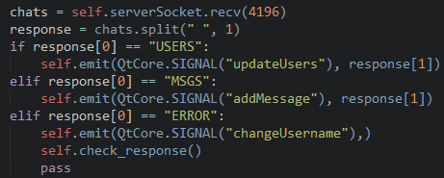
Signal / Slot Architecture

Slide 8
Version 2.0
Language Translation
Change Name
Updated GUI
Updated Client Requests

Slide 9
Language Translation
Google translate
Handled serverside
New “LANG” request
Client Tuples now contain a fourth slot for language

Slide 10
Change Name
Updated serverside “NAME” handling
Client now sends “NAME” request when receives signal from GUI

Slide 11
Updated GUI
File menu
Change Name option
Name prompt upon opening
Change Language option
Help menu
Displays Language

Slide 12
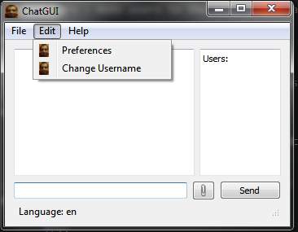
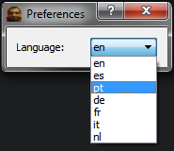
Updated GUI

Slide 13
Updated Client Requests
Client sending and receiving of requests now separated
Ensures proper handling of requests no matter what order they come in

